Slide 1
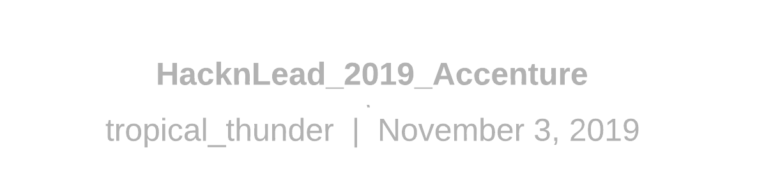
Focalearn
Team Tropic Thunder
Flavio Lombardo
Jeff Franzke
Lukasz Gintowt
Tobias Türing
Nataliya Guts

Slide 2

Notes:
Mention Blockchain
Society is getting more complex with all the new technologies

Slide 3
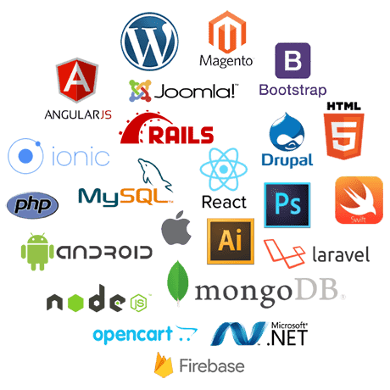
Notes:
Mention Blockchain
Society is getting more complex with all the new technologies

Slide 4
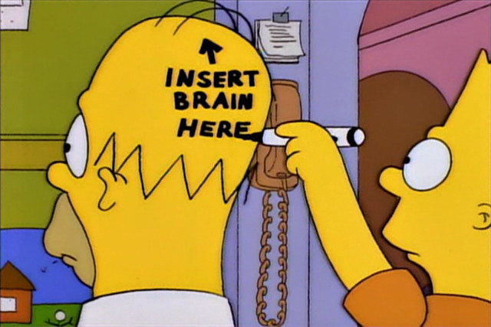
Notes:
Technology is evolving fast, developers have to keep up to date and continue learning
People are getting old and slow and have no time
Young people are sponges and have time to learn new things, but do not have the experience
Businesses want everything done and working yesterday
The past is history, the future is a mystery, and the present is a gift

Slide 5
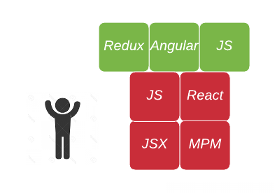
Notes:
Felix is an experienced coder.
For his next project he needs React.
we use Machine Learning (Char_rnn) to analyse Felix’s coding skills Looking at his github.
We think that the best way to learn is to have more social interaction.
We reuse the tool to find MATCHING TUTORS

Slide 6
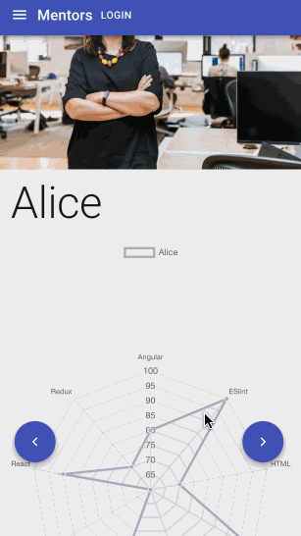
Notes:
Alice and Bob both know React. ( Felix sees that Alice also knows Angular like him, so she will be a better tutor for him.)
He contacts Alice, using the conversation starters.

Slide 7
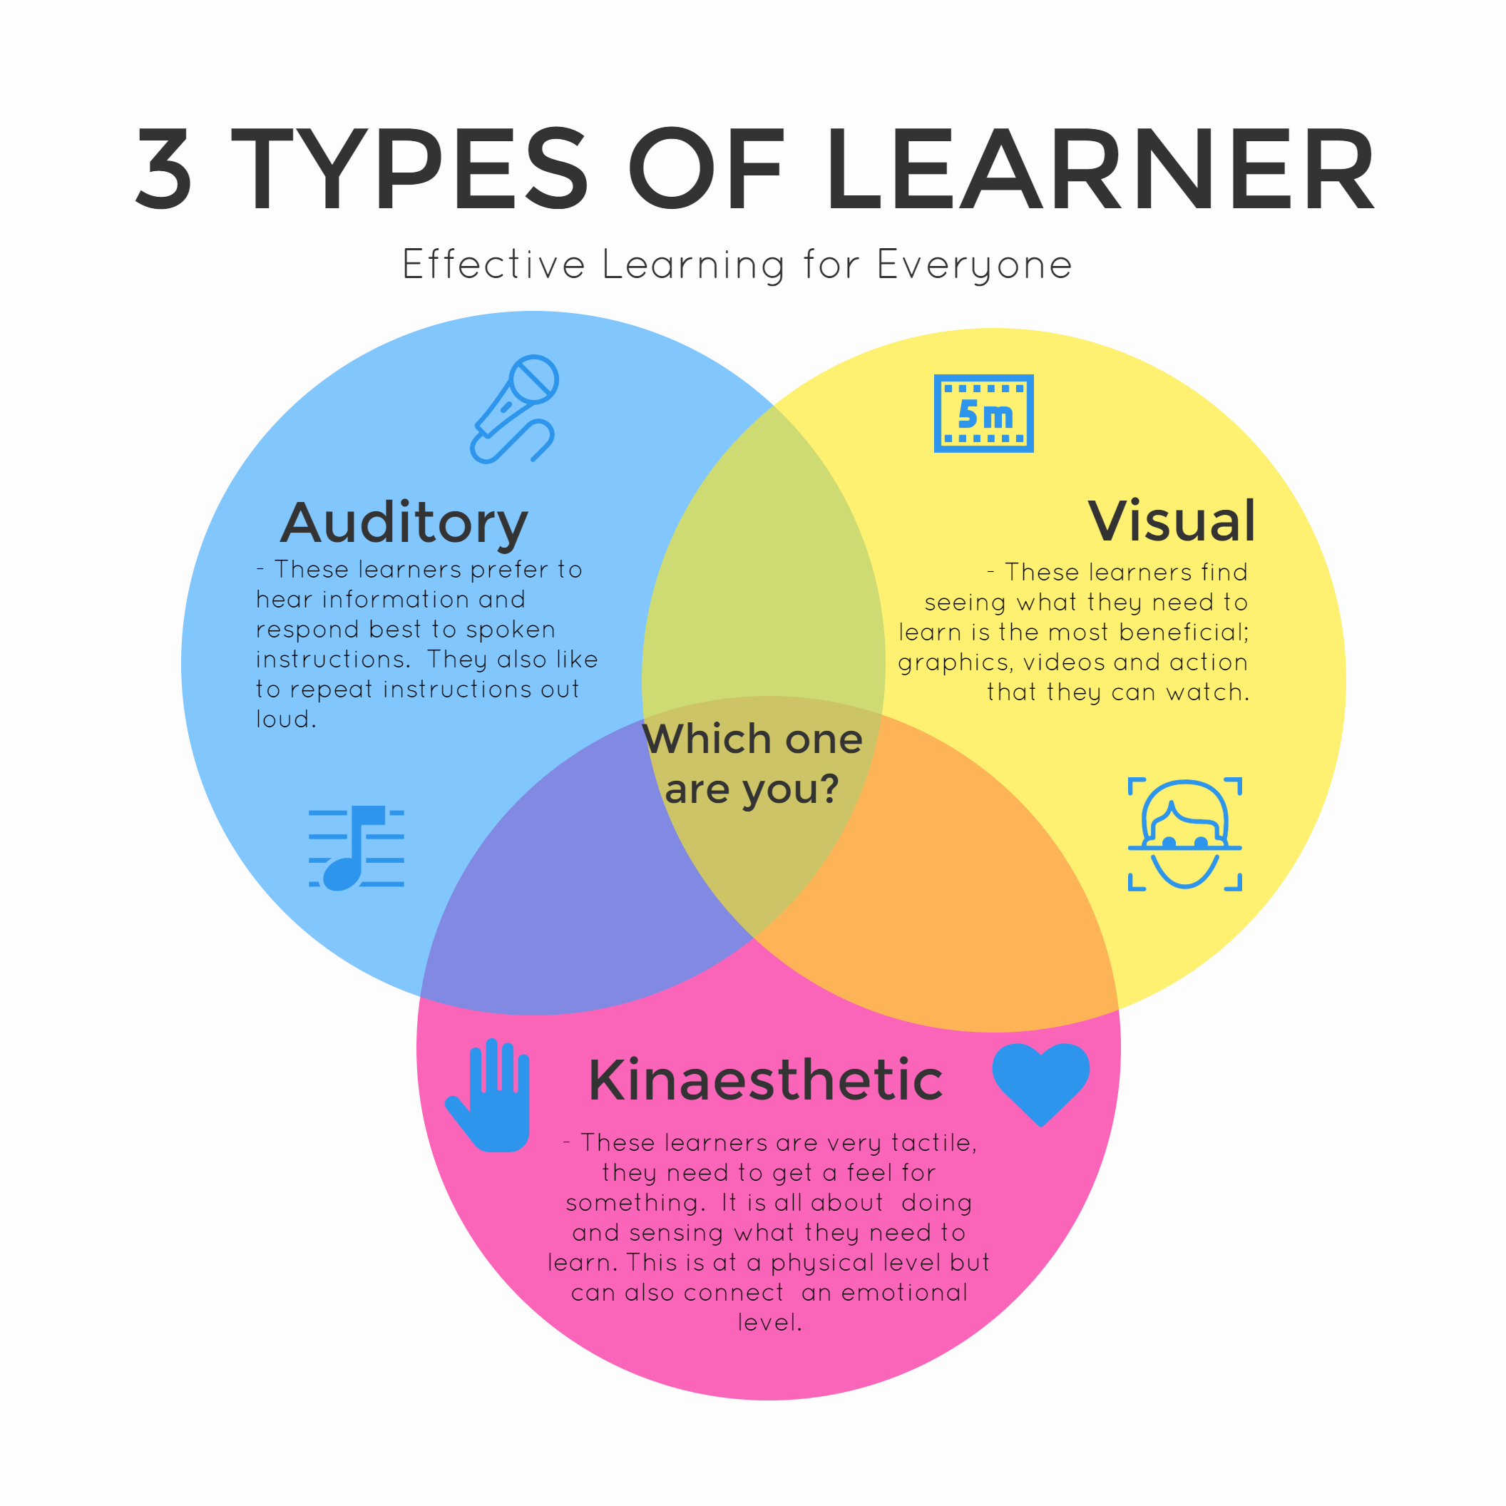


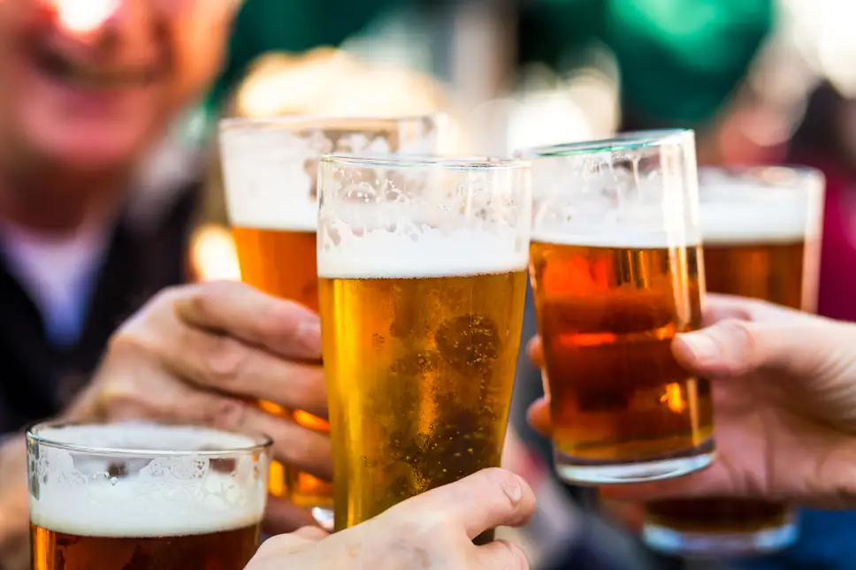



How you proceed with your tutor is up to you

Slide 8

Business
Cloud based SaaS
Subscription based - Pay per user

Slide 9

Learn only what YOU need and have MORE FUN
Notes:
For example within the company
Ok Tech

Slide 10
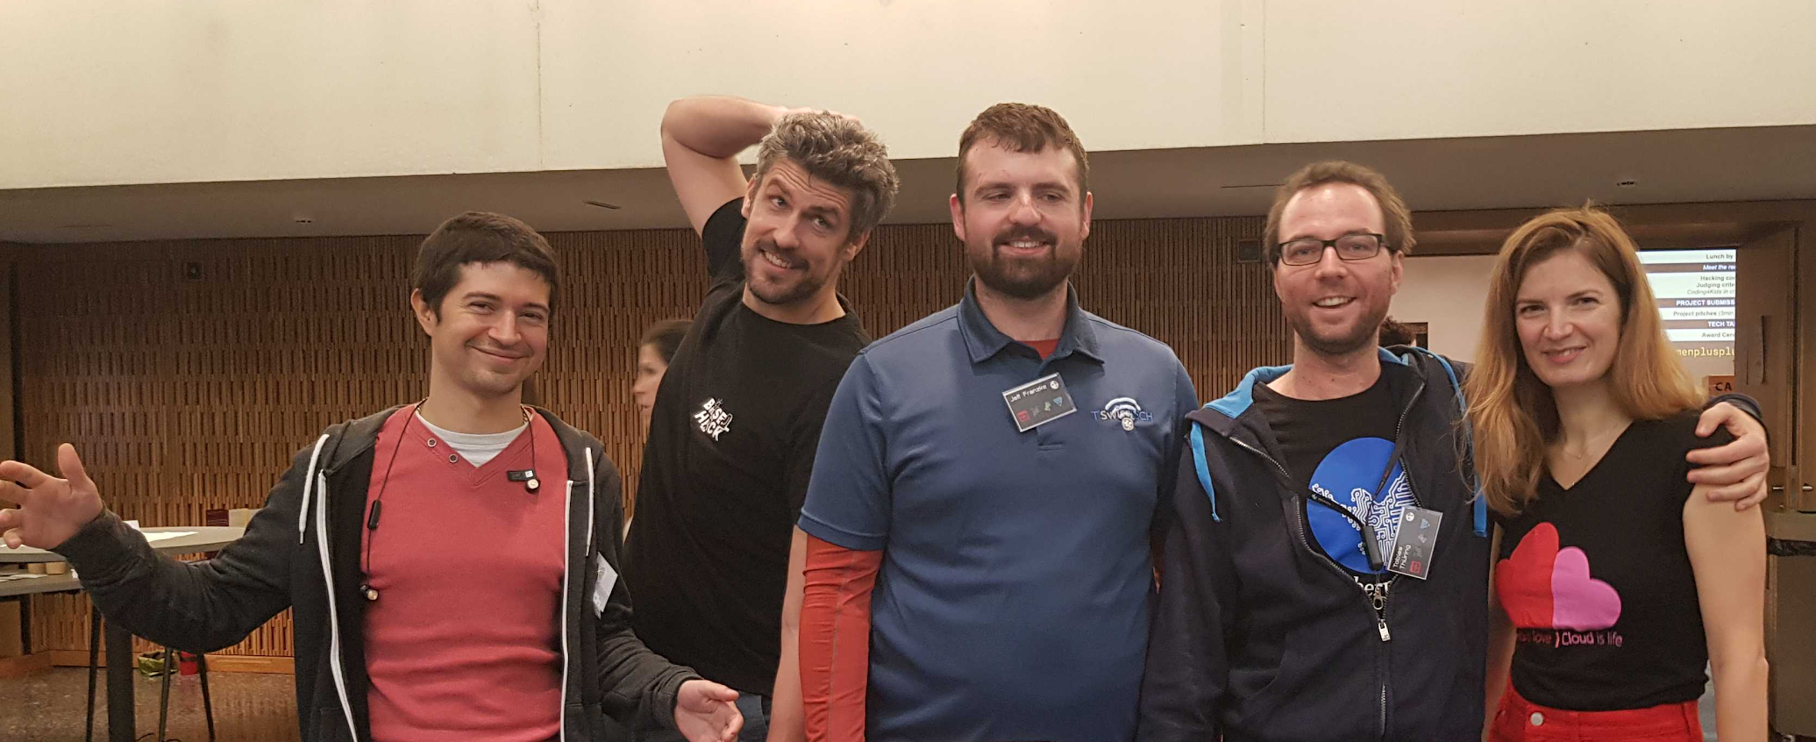
Happy learning and thank you!
Picture of the team

